Slide 1
S-6 | SLO-1 | Changing the Counter Modulus
 | SLO-2 | Decade Counters

Slide 2
Counter
Counters are sequential logic devices that are activated or triggered by an external timing pulse or clock signal.
A counter can be constructed to operate as a synchronous circuit or as an asynchronous circuit.
With synchronous counters, all the data bits change synchronously with the application of a clock signal.
Whereas an asynchronous counter circuit is independent of the input clock so the data bits change state at different times one after the other.
The number of states or counting sequences through which a particular counter advances before returning once again back to its original first state is called the modulus (MOD).
In other words, the modulus (or just modulo) is the number of states the counter counts and is the dividing number of the counter.

Slide 3
Synchronous Mod Counter

Slide 4
Modulus Counter
Modulus Counters, or simply MOD counters, are defined based on the number of states that the counter will sequence through before returning back to its original value.
For example, a 2-bit counter that counts from 00₂ to 11₂ in binary, that is 0 to 3 in decimal, has a modulus value of 4 ( 00 → 1 → 10 → 11, and return back to 00 ) so would therefore be called a modulo-4, or mod-4, counter.
Counters can be designed to count to any number of 2^{n} states in their sequence by cascading together multiple counting stages to produce a single modulus or MOD-N counter.
Therefore, a “Mod-N” counter will require “N” number of flip-flops connected together to count a single data bit while providing 2^{n} different output states, (n is the number of bits).

Slide 5
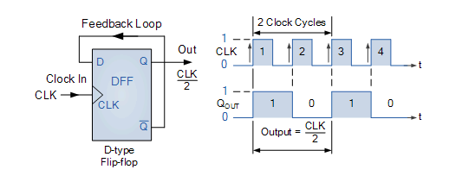
Mod 2 Counter
The edge-triggered D-type flip-flop is a useful and versatile building block to construct a MOD counter or any other type of sequential logic circuit.
By connecting the Q output back to the “D” input as shown, and creating a feedback loop, we can convert it into a binary divide-by-two counter using the clock input only as the Q output signal is always the inverse of the Q output signal.

Slide 6
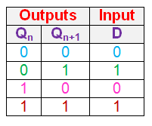
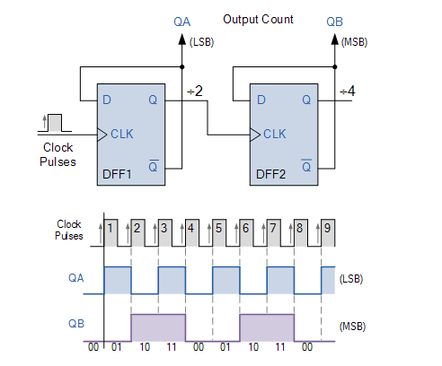
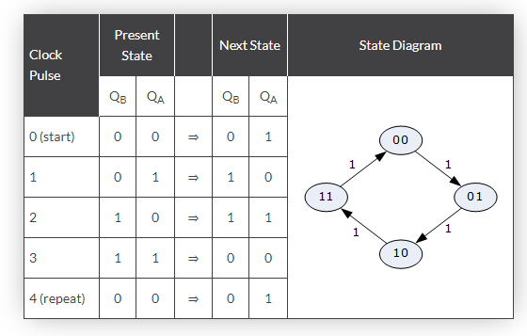
Mod 4 Counter

Slide 7
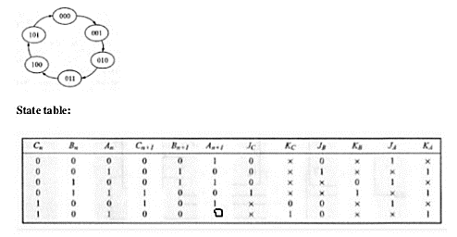
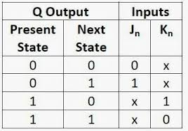
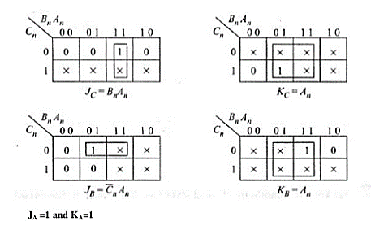
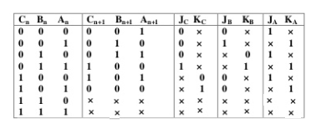
Mod 6 Counter

Slide 8
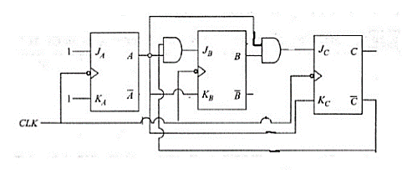
Mod 6 Counter

Slide 9
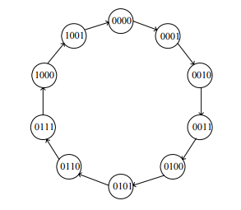
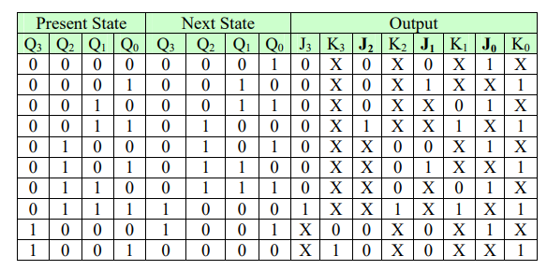
Decade Counter (Mod 10 Counter)

Slide 10
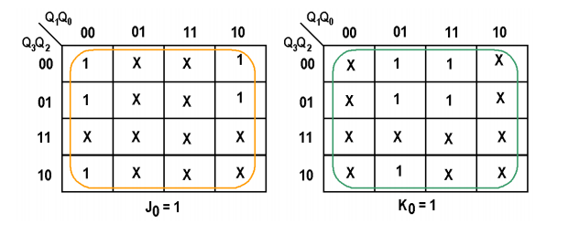
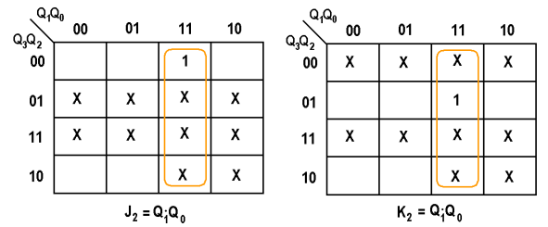
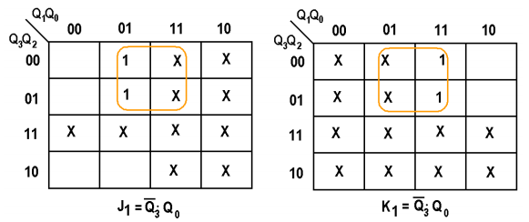
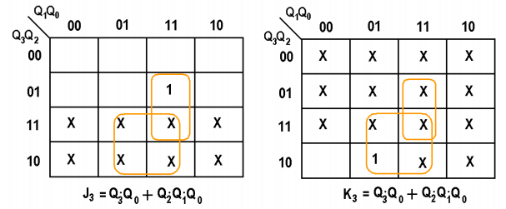
Decade Counter (Mod 10 Counter)

Slide 11
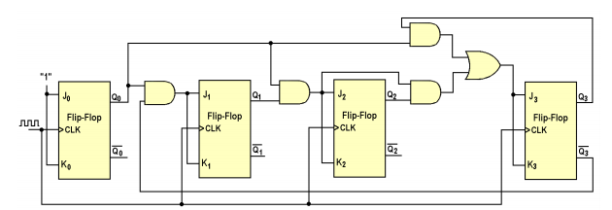
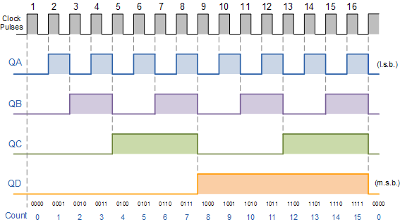

Decade Counter (Mod 10 Counter)

Slide 12
Asynchronous Mod Counter

Slide 13
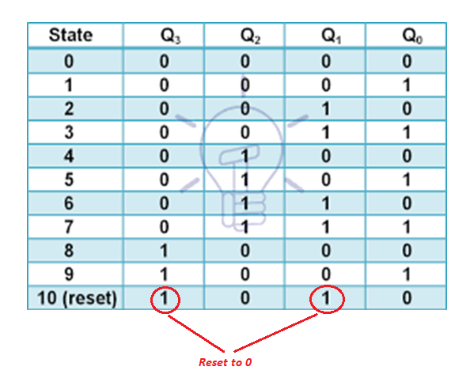
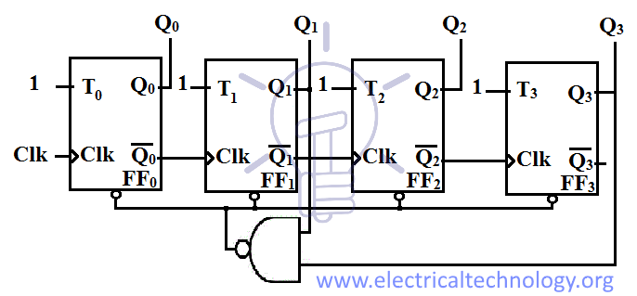
Asynchronous Decade Counter

Slide 14
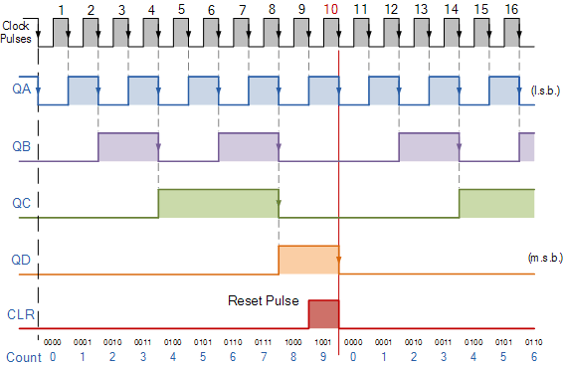
Decade Counter Timing Diagram

Slide 15
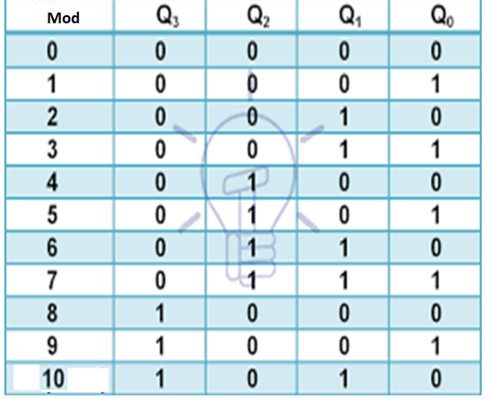
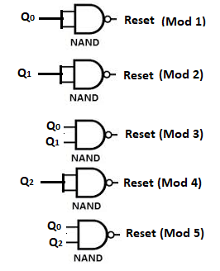
Asynchronous Modulus Counter
Similarly other Mod counters can be obtained.

Slide 16
S-7 | SLO-1 | Presettable counters
 | SLO-2 | Counter Design as a Synthesis problem

